Slide 1
Camp GLEA Sustainable Carolina & College of Education USC Summer 2013
Dr. Beth Costello: bethpcostello@gmail.com
Seth Guest: guestsi@mailbox.sc.edu

Slide 2
Background/Purpose
South Carolina ranks near the bottom – 43rd among the 50 states – in a ranking of children’s well-being.
Opportunity gaps resulting in achievement gaps
Gaps in US and global achievement in STEM subjects
Summer slide issues
Food desserts in low-income neighborhoods
Need to increase health awareness (e.g. rising obesity rates, sedentary life styles, processed food etc.)
Need for recreation (e.g. interaction with nature & physical activity)

Slide 3
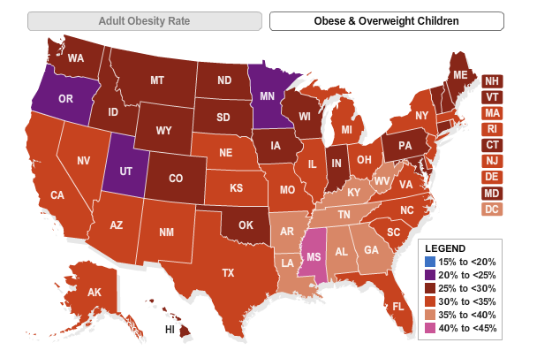

Slide 5
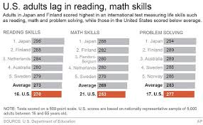

Slide 6
Camp glea
What?: A two week camp
When?: Five days per week, three hours per day, June 2013
Where?: Green Quad/Sustainable Carolina gardens and buildings
Why?: Issues of opportunity gaps, summer slide, and needs of children
How?: Gardening, literacy, environmental and arts-based lessons

Slide 7
Project glea solutions
Overcoming the summer slide
Cross-curriculum & arts based learning
Critical thinking
Hands-on learning
Nature and human ecology
Nutritional choices
Food Systems and food access

Slide 8
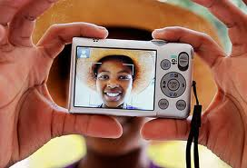
Literacy Through Photography
Created in the 1980’s by Photographer Ewald and her associates at the Duke Center for Documentary Studies
Kids create their own images that serve as catalysts for critical thinking, dialogue and decision making

Slide 9
Gardening Curriculum
Composting
Food Systems
Soil and soil experiments
Rainbow of foods and nutrition
Sequence and sequencing
Parts of a plant-root, leaf, & stems
Healthy Snacks
Cooking
Fruits, vegetables, nuts, and seeds

Slide 10
A Brief View of Our camp

Slide 11
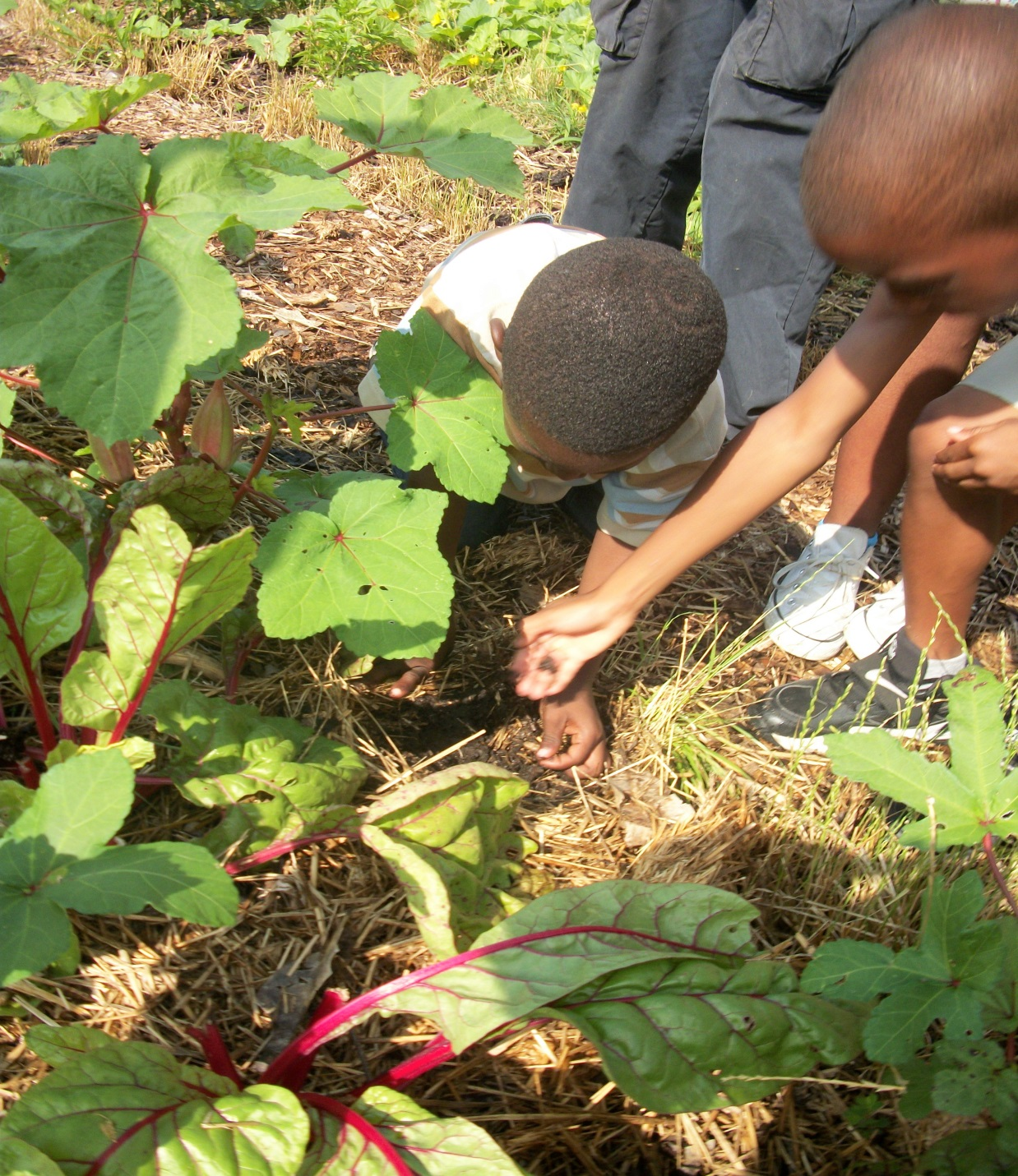
Garden Tour

Slide 13
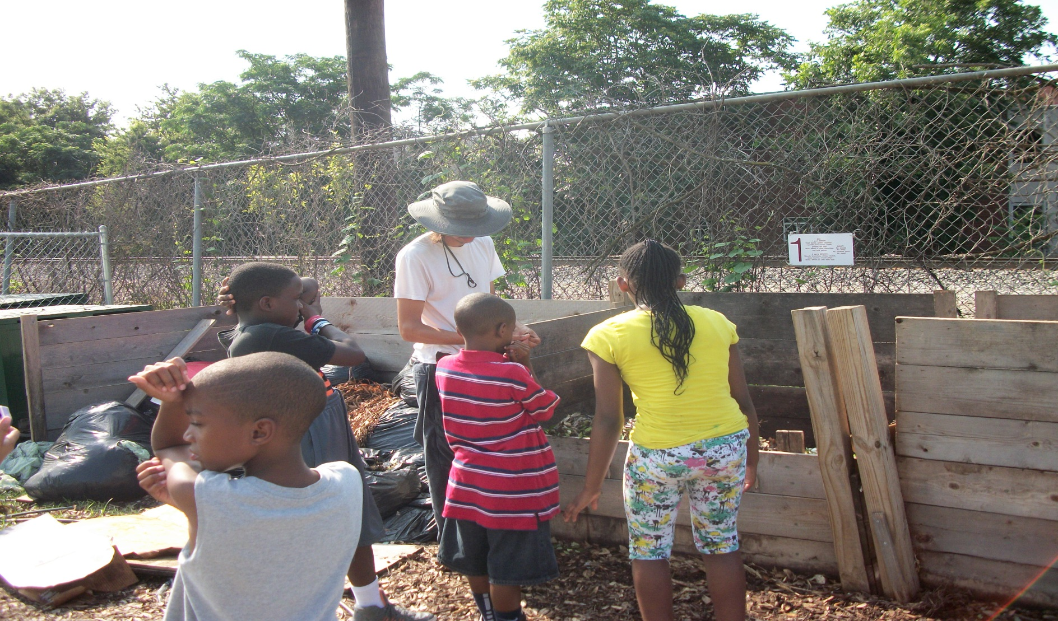
Compost

Slide 14
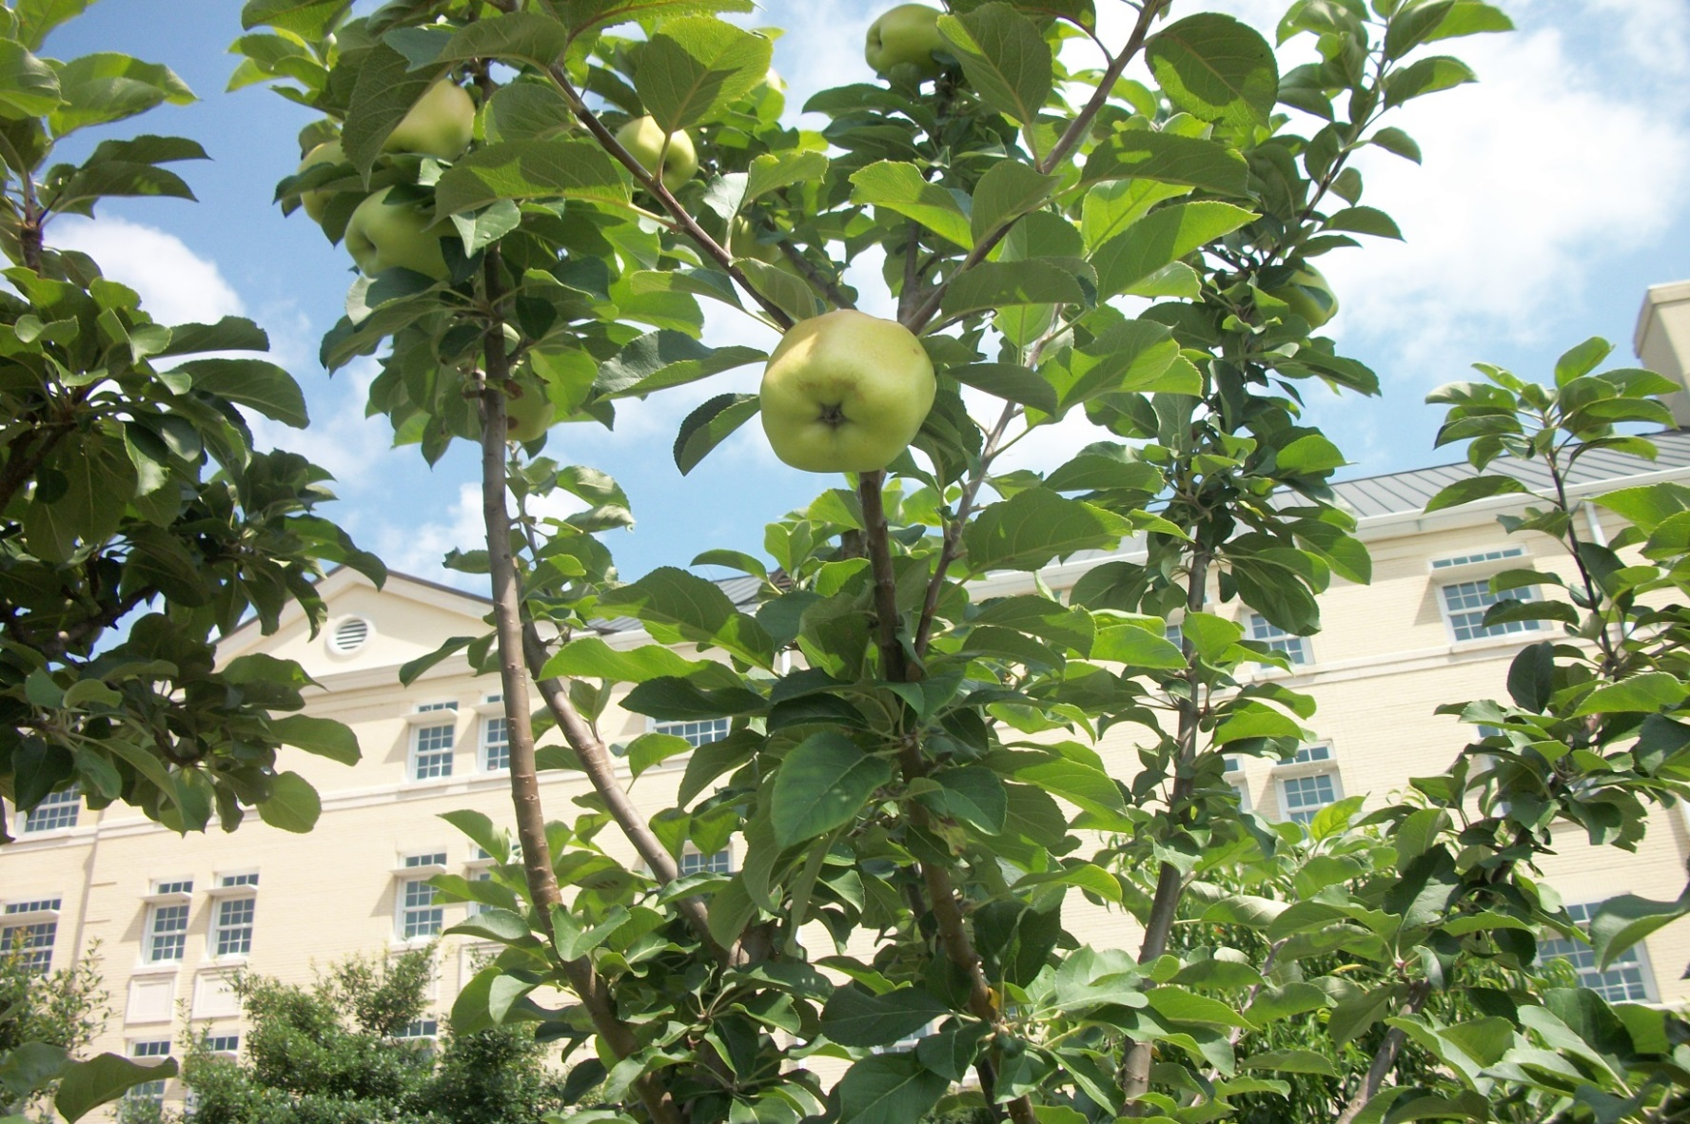
Alphabet Walk: A-Apple

Slide 15
F-Fig

Slide 16
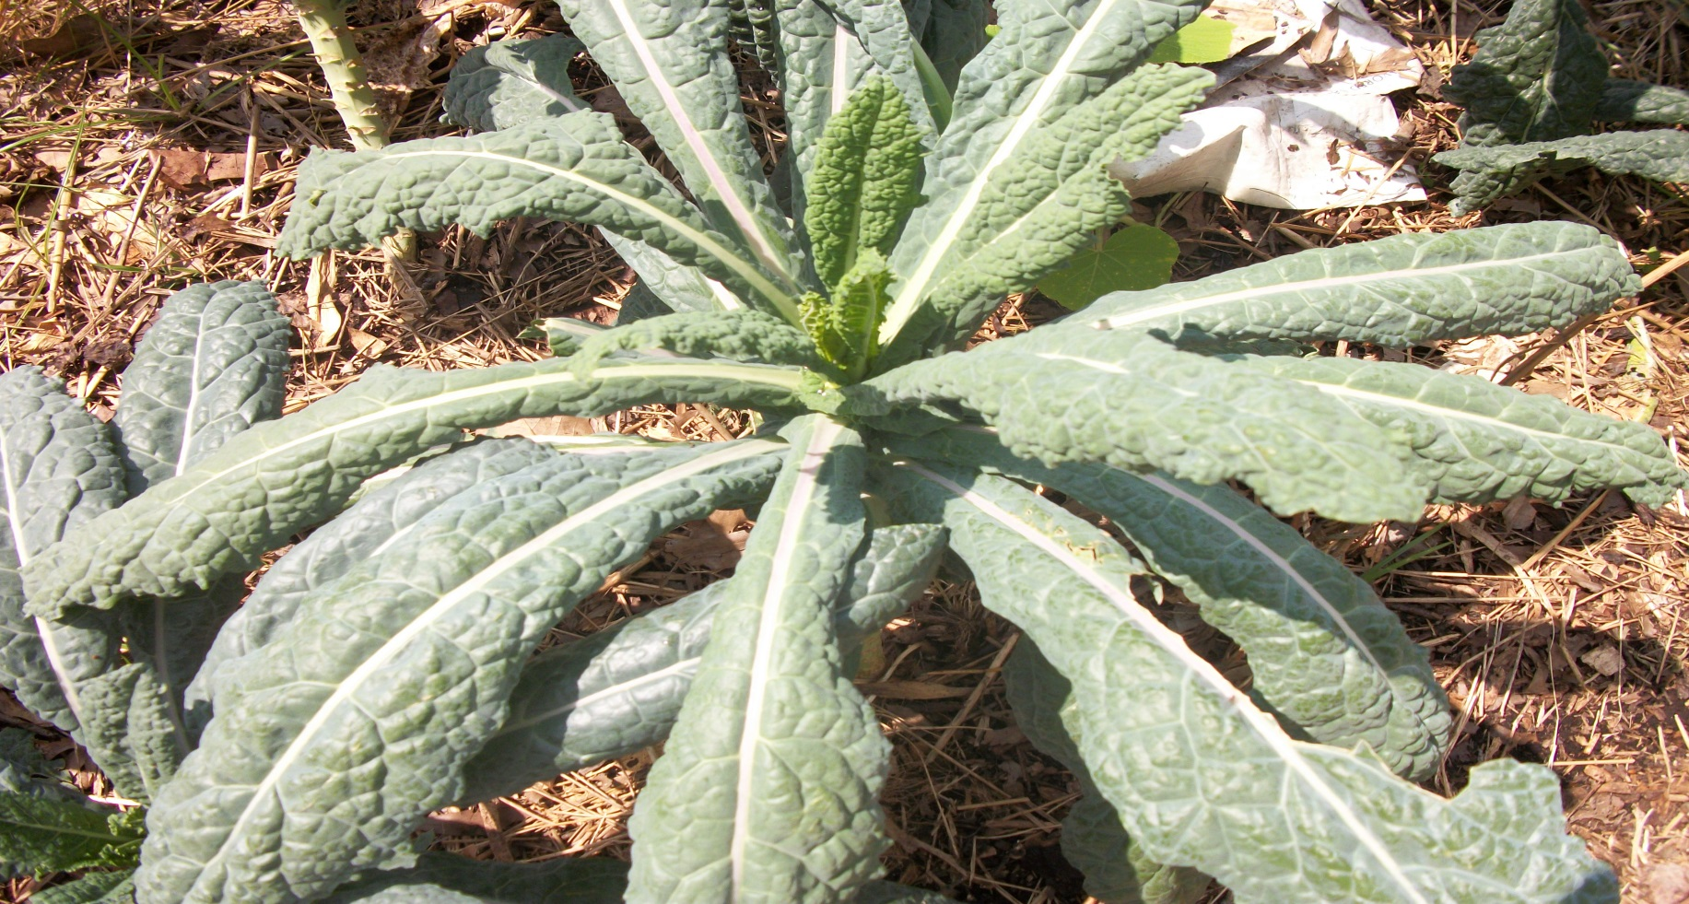
K-Kale

Slide 17
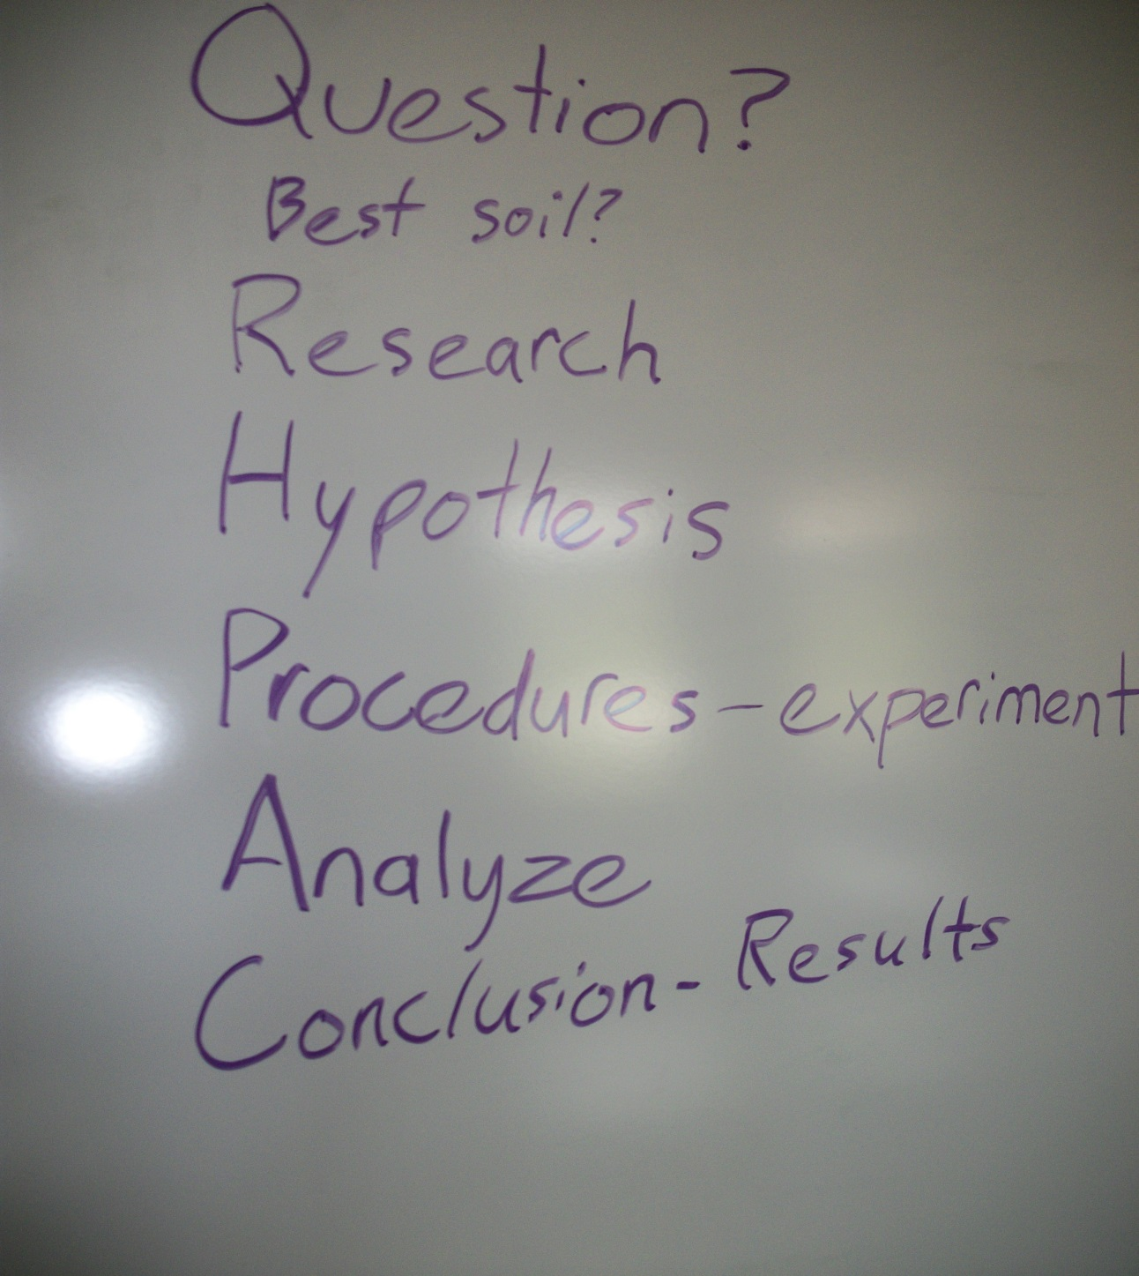
The Scientific Method

Slide 18
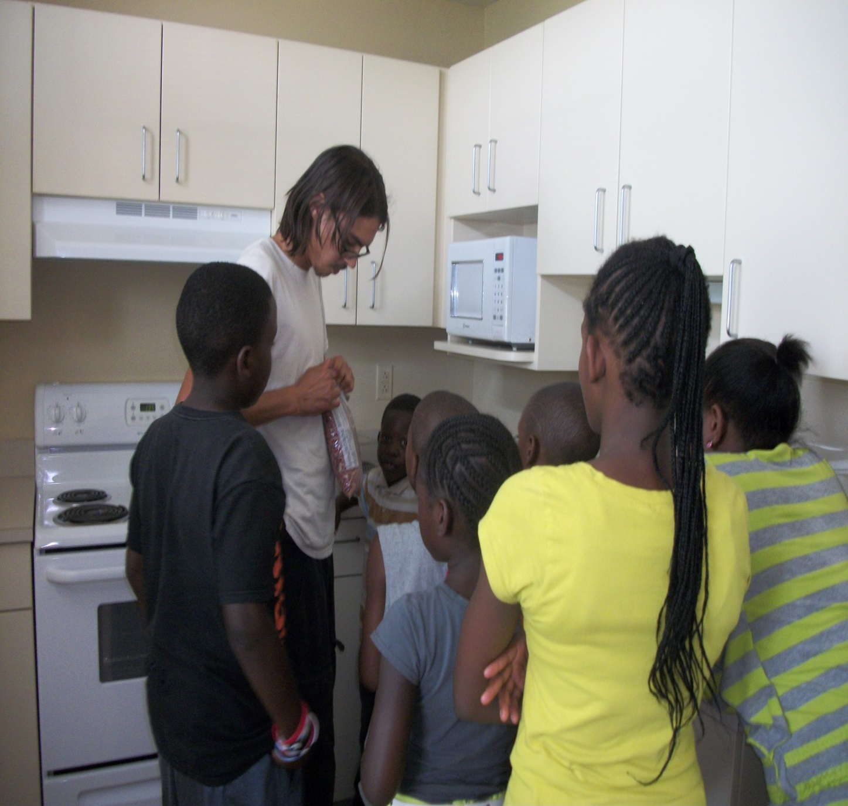
Soil Experiment
Flour=Sand
Beans=Clay

Slide 20
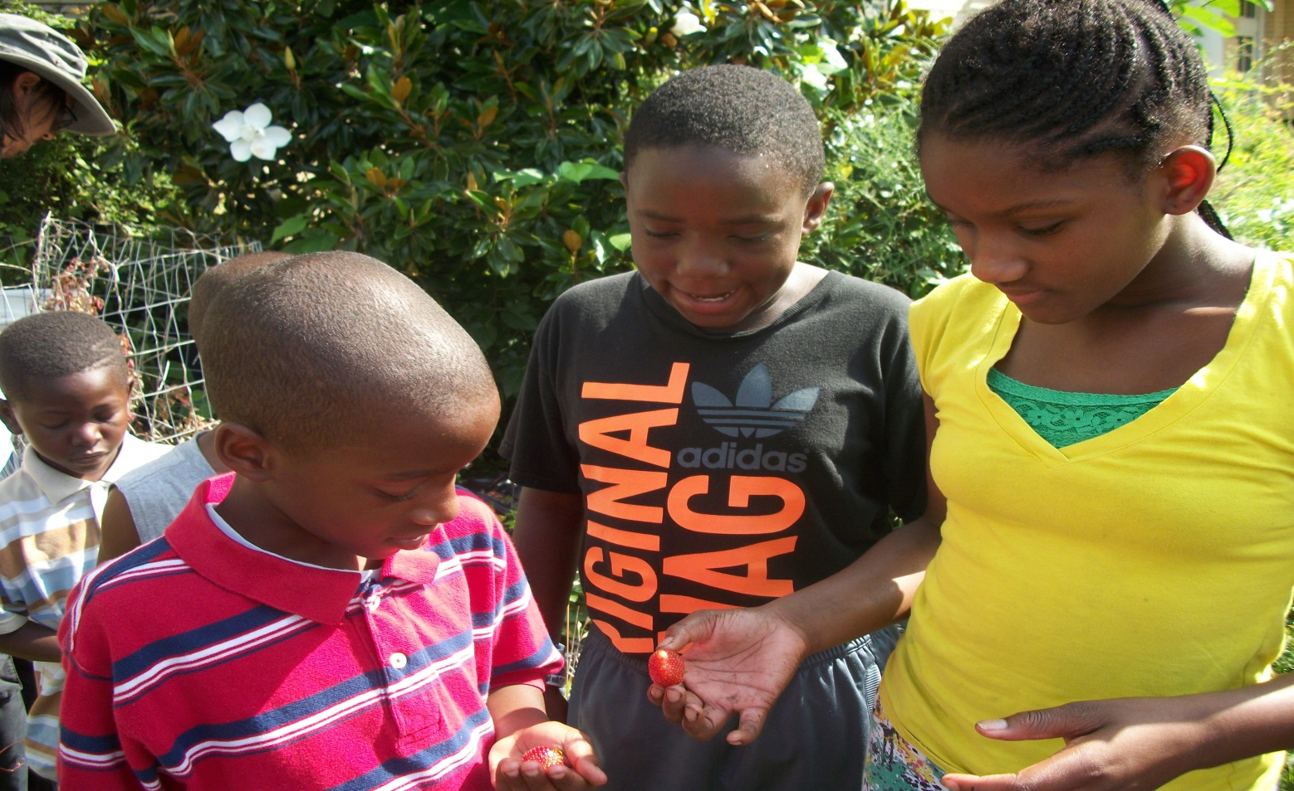
Parts of a Plant
Fruit
Leaf
Stem
Root

Slide 21
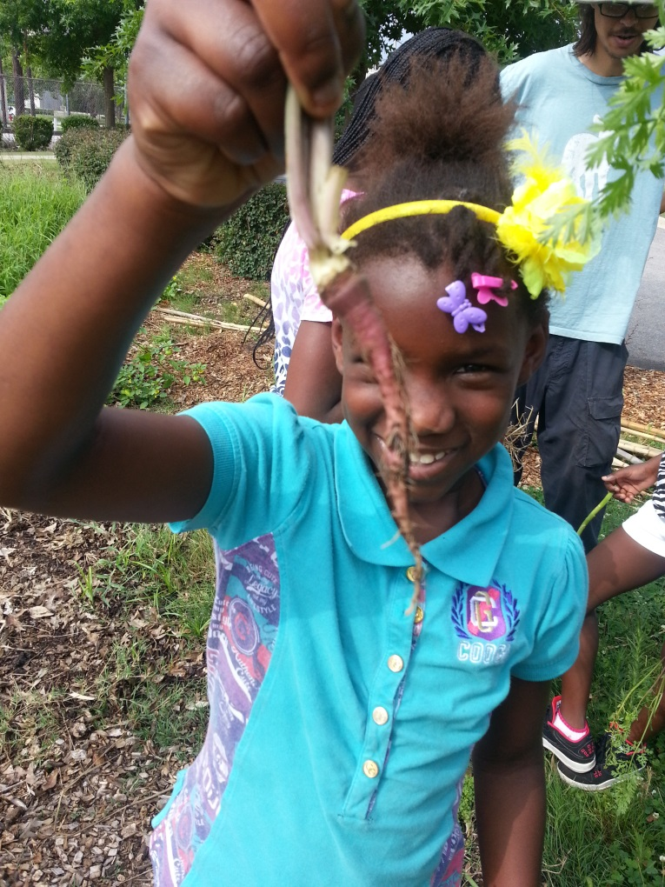
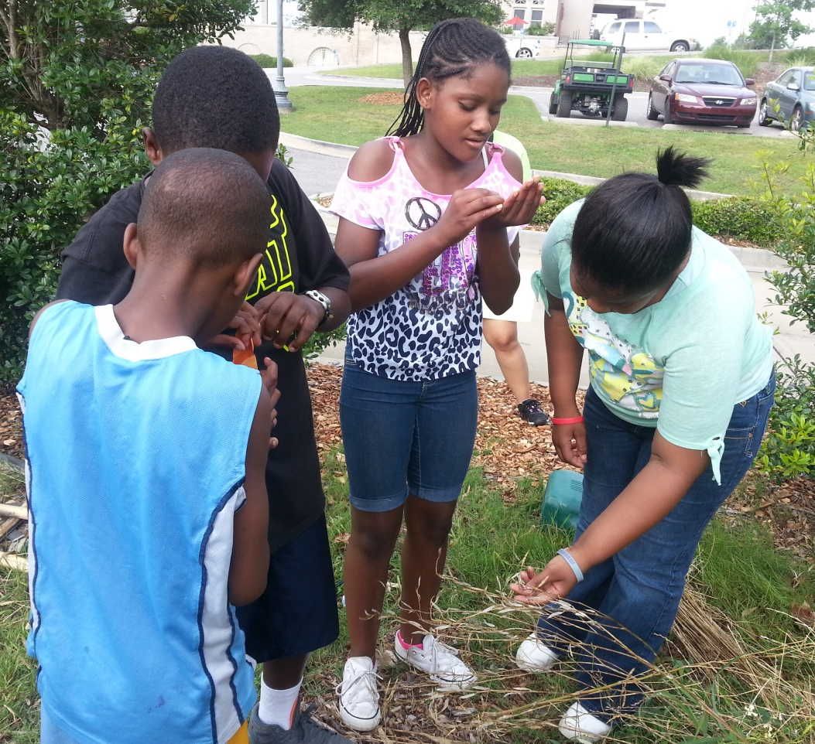

Slide 22
Parts of Plants: Best part of me

Slide 23
My body
I chose my whole body. Do you want to know why? I can use my body for different things. Like jumping, running, dancing, gymnastics, and playing outside. My body is great, strong, helpful, flexible, and beautiful. So now can you see my body can do different things?

Slide 24
My Whole Body
I like my whole body because it helps me in football when I run the ball because you need to be fast , strong ,and small.
My body in basketball because it helps me shoot the ball , passing ,and crossing people up and , jumping.
I use my body by riding my bike for balance and strong leg and , sometime do tricks.

Slide 25
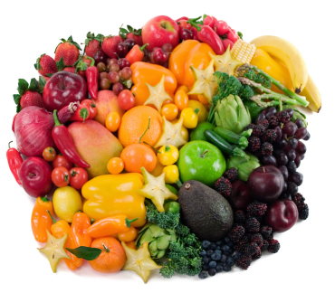
EarthFare Nutrition Talk: Rainbow of nutrition

Slide 26
Math Keyhole Garden

Slide 27
Trip to the Farmers Market

Slide 28
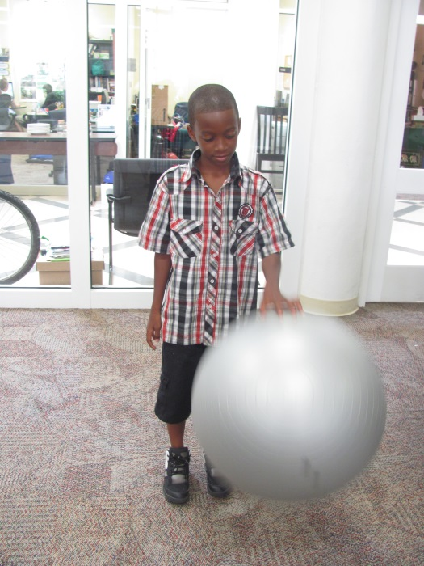
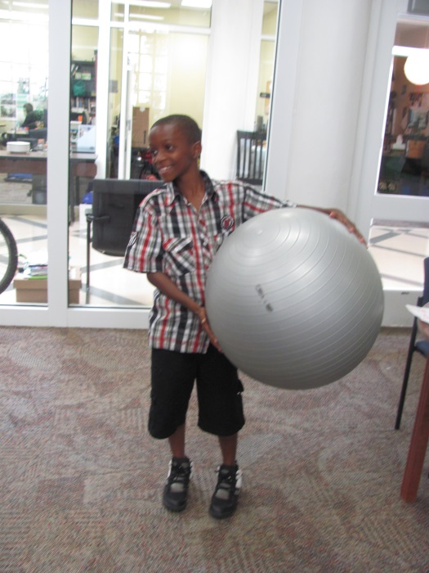
Sequences

Slide 29
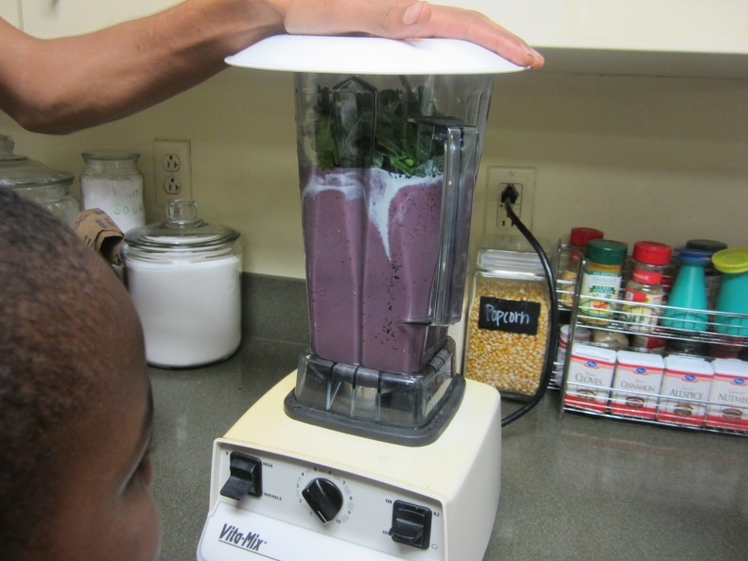
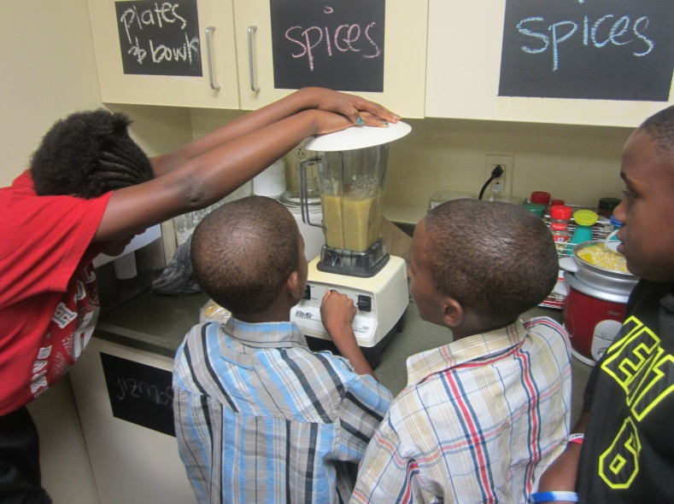
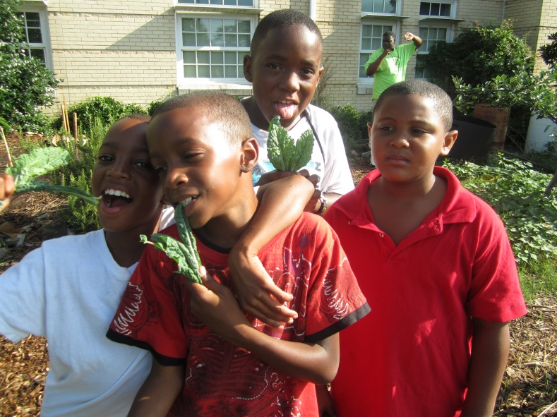
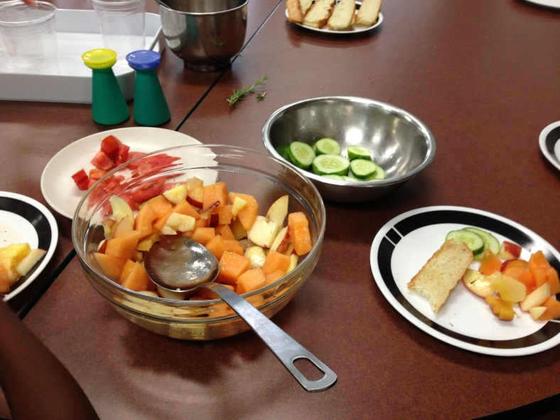
Healthy Eating

Slide 30
Assessment
Daily debriefs reviewed the days activities and material covered
A final video recorded group discussion evidenced participants’ recall of focuses in sustainability and nutrition and the arts and science integrated into the curriculum.

Slide 31
Conclusions
A collaborative arts and science based curriculum during school breaks supports academic advancement.
Learning about gardening and nutrition addresses current hurdles in learning opportunities that affect health while curriculum that corresponds to school subjects furthers academic advancement.
A longer camp could better prepare participants to cook healthy meals and begin their own gardens at home and in their communities.
Participants expressed excitement in learning and trying new fruits and vegetables.

Slide 32
With special thanks to:
Local Community
USC
Jackie Williams &
City of Columbia Department of Parks and Recreation
Matthew Costello &
Eau Claire Promise Zone
Earth Fare, Columbia
Arlene Maturano &
Center for Science Education
Office of Sustainability
USC Green Quad
Dean Lemuel Watson &
College of Education

Slide 33
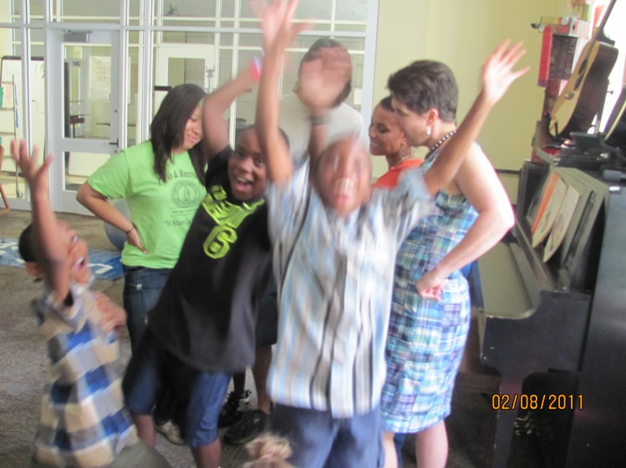
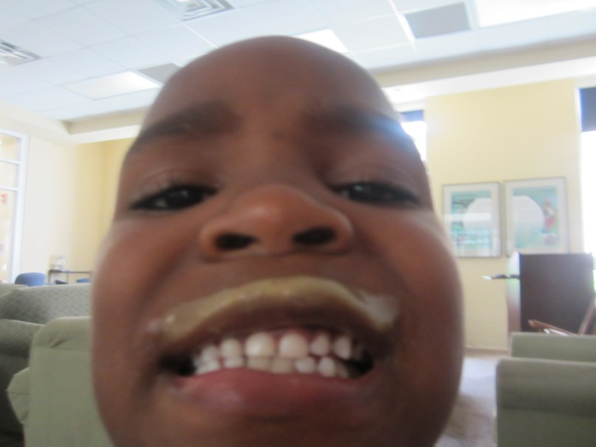
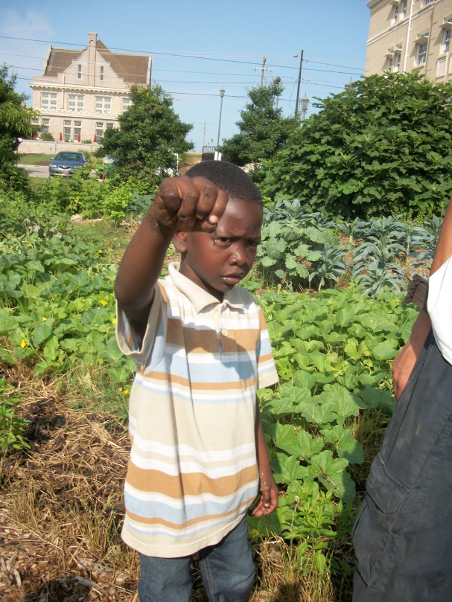
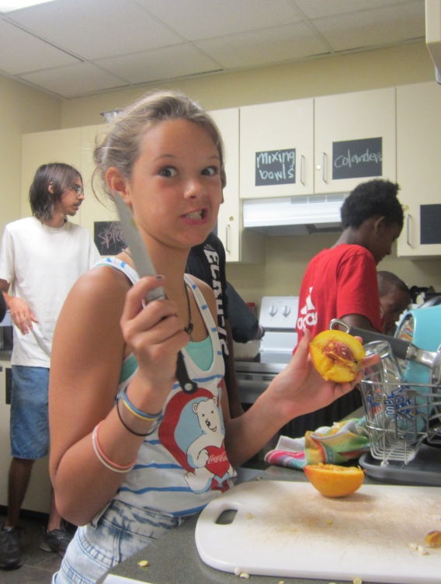
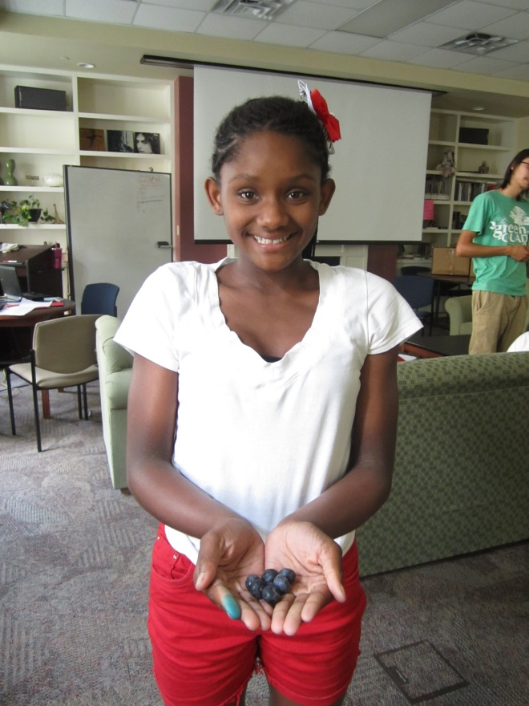
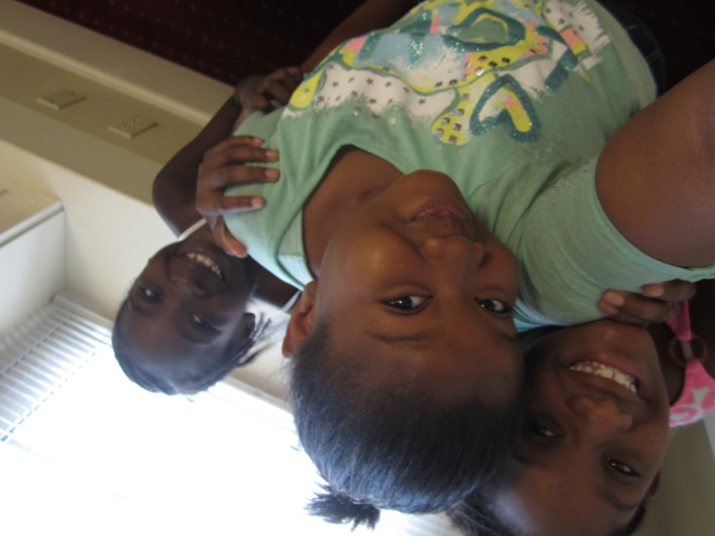

Slide 34
