Slide 1
The Storyteller Project: Exploring the Efficacy of Narrative Strategies for Promoting Childhood Obesity Prevention among Mothers of Mexican American Preschoolers
Rachel E. Davis, Ph.D., Suzanne Cole, Ph.D., Shannon McKenney, M.P.H., Ligia Reyes, M.P.H., Karen E. Peterson, Sc.D.
University of South Carolina Nutrition Symposium,
March 21, 2014

Slide 2
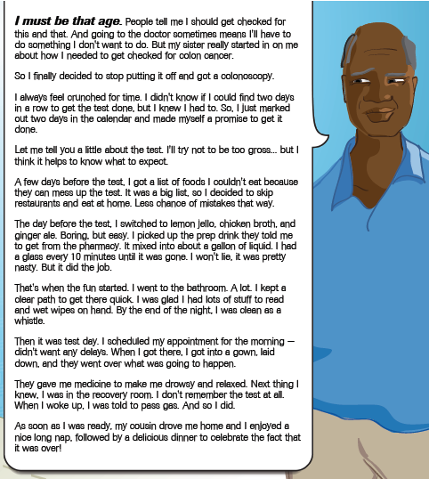

Slide 4
What Is a Narrative?
“(A)ny cohesive and coherent story with an identifiable beginning, middle, and end that provides information about scene, characters, and conflict; raises unanswered questions or unresolved conflict; and provides resolution.”¹
¹ Hinyard, L.J., & Kreuter, M.W. (2007) Using narrative communication as a tool for health behavior change: A conceptual, theoretical, and empirical overview. Health Education & Behavior, 34(5): 977-792.

Slide 5
Study Design
Study goal:
To obtain feedback on childhood obesity prevention narratives
Participants:
Mexican American mothers of children ages 3-4 (n = 40)
Special Supplemental Nutrition Program for Women, Infants, and Children (WIC) clients, Community Health and Social Services Center
Children consumed greater than recommended levels of sugar-sweetened beverages (SSBs)
Data collection:
Participants completed two face-to-face interviews
1st interview: survey
2nd interview: exposure to 1 narrative from each of 2 sets of narratives
All second interviews were completed in Spanish
Participants received a $25 gift certificate to a local grocery store

Slide 6
Participant Characteristics (n=40)
Age:
Mean age in years (mothers) | 32.1
Mean age in years (children) | 3.6
Nativity:
Foreign born (mothers) | 98%
Mean years lived in the U.S. (foreign-born mothers) | 11.8
Married or Living with a Partner | 83%
Educational Status:
Less than 8th grade | 25%
Between 8th and 11th grade | 15%
High school diploma/GED | 50%
Some college or college graduate | 10%
Mean hours of screen time per day (children) | 6
Mean hours of active play per day (children) | 1.2

Slide 7
Story #1: Reducing SSB Intake
Setting:
Version A: Family dinner at home
Version B: Dinner with extended family at the grandparents’ house
Plot:
Crisis: Child demands a SSB (Version A) or is given a SSB by an aunt (Version B)
Mother (protagonist) recalls a conversation with a WIC nutritionist (nutrition messages)
Resolution/Action: Mother gives the child water

Slide 8
Story #1: Nutrition Messages
“… I saw the nutritionist at the WIC clinic the other day … She explained that flavored drinks - like Gatorade, Sunny Delight, and Jumex - have a lot of sugar in them. That means that Manuel may be more likely to have health problems. She told me that drinking one bottle of Gatorade is the same as having 5 packets of sugar! I knew Gatorade wasn't healthy, but I had no idea it had so much sugar! The nutritionist also said that Manuel drinks too much fruit juice and chocolate milk. I thought that it was good to give juice to kids Manuel's age and that it was okay to put chocolate or strawberry in the milk if it made him more likely to drink it. The nutritionist and I talked about how he needs to gain weight as he grows in a healthy way, like from the protein in low-fat milk, and not from sugar. So, instead of sugary drinks, he should mostly just be drinking plain water. After I saw the nutritionist, I called my doctor to talk about what I had heard. The doctor said it's good to give kids only one small glass of juice and two glasses of white milk each day. Other than that, give them plain water …”

Slide 9
Story #1: Action
“… I remembered I had brought Manuel's special Superman cup and that I had just seen some colorful straws in one of Mamá's kitchen drawers. I went and got the cup, then filled it with some chipped ice and cool water. I plopped an orange straw in it - his favorite color - and took it to the table where the kids were eating. On my way I grabbed a slice of ripe, sweet watermelon from the adults' table. Manuel was munching on some carrot sticks but keeping his eyes on everything his cousins were doing … I leaned down and said, "Hey, dulce pequeñito, here's some watermelon for you! And I found your Superman cup." I put the watermelon in his warm hand and put the Superman cup down in front of the cup of Gatorade. He didn't even seem to notice the cup as he was so focused on the watermelon. While he was getting ready to take a bite of the watermelon, I took the Gatorade cup and walked back towards the adults' table. As I walked away, I heard the older kids say, "Watermelon! Where'd you get that?! Tía Marta!" I sneaked a look back and could tell that Manuel was pleased to have gotten his cousins' attention …”

Slide 10
Story #1: Recall of Nutrition Messages
Message | Version A (Home) | Version B (Grandparents’ House)
#1: Sweet drinks have lots of sugar | 20% | 40%
#2: Sugar is bad for children’s health | 20% | 20%
#3: Drink mostly water and not SSBs | 53% | 58%
#4: Drink no more than 1 glass of juice per day | 23% | 18%
#5: Drink no more than 2 glasses of milk per day | 33% | 28%

Slide 11
Story #1: Recall of Nutrition Messages
Message | Version A (Home) | Version B (Grandparents’ House)
#1: Sweet drinks have lots of sugar | 20% | 40%
#2: Sugar is bad for children’s health | 20% | 20%
#3: Drink mostly water and not SSBs | 53% | 58%
#4: Drink no more than 1 glass of juice per day | 23% | 18%
#5: Drink no more than 2 glasses of milk per day | 33% | 28%

Slide 12
Story #1: Recall of Nutrition Messages
Message | Version A (Home) | Version B (Grandparents’ House)
#1: Sweet drinks have lots of sugar | 20% | 40%
#2: Sugar is bad for children’s health | 20% | 20%
#3: Drink mostly water and not SSBs | 53% | 58%
#4: Drink no more than 1 glass of juice per day | 23% | 18%
#5: Drink no more than 2 glasses of milk per day | 33% | 28%

Slide 13
Story #2: Limiting TV Watching
Emotional arousal:
Version C: High emotional arousal
Version D: Low emotional arousal
Plot:
Crisis: Doctor tells the mother (protagonist) that child is overweight, needs more physical activity, and to turn off the TV
Mother and child return home; child watches TV
Resolution/Action: Mother engages child in fixing lunch; turns off TV
Resolution/Action: Mother engages child in cooking dinner and dancing (TV is never turned on)
Conclusion: Mother plans to go to the library to get cookbooks for kids as an alternative to watching TV
Although cooking activities are featured, this story does not contain any nutrition messages

Slide 14
Story #2: Emotional Arousal
Version C (High Emotion)
Version D (Low Emotion)
“The TV sat dark and silent as Daniella’s laughter floated through the kitchen like the sweet smell of the simmering tomatoes and chicken bubbling on the stove. My heart was as warm as the kitchen as I watched my daughter’s tiny hand fumble with the handle of the long wooden spoon, as she mixed the dressing into our salad. I thought about how worried I felt this morning. Now, it felt like I could finally catch my breath …”
“The TV remained off while Daniella and I made dinner. Daniella mixed the dressing into our salad, as I stirred the tomatoes and chicken on the stove. When Daniella was finished, she hopped off of the stool, and asked if she could wash her hands. I picked her up and we leaned over the kitchen sink and washed traces of salad dressing from Daniella’s hands. Daniella dried her hands while I seasoned the food in the pot. As I tasted the sauce, I thought about her doctor’s appointment earlier this morning …"

Slide 15
Story #2: Limiting TV Messages
“… This morning, at Daniella’s yearly check-up, the doctor told me that Daniella was too heavy for her age … Daniella may have a little extra weight on her, but she’s only four. Once she gets older and taller, she will slim down. She’s a strong and healthy little girl. That’s how kids should be. I don’t want anyone thinking that my kids don’t have enough to eat. Dr. Gonzales said one way to get Daniella to be more active was turning off the TV. That’s easy for him to say. He doesn’t live in my neighborhood. Keeping her inside means keeping her safe. Besides, between my two kids and my husband, sometimes putting them in front of the TV is the only way that I can get things done … When we got home, Daniella sat down to watch cartoons. The Dr.'s words buzzed around in my head like a mosquito - risks, diabetes, high blood pressure …”

Slide 16
Story #2: Action
“… As I started making her lunch, she turned from her cartoons and asked if she could help me. My usual answer would be no. I could do it faster and with less of a mess, but this time, I thought, why not? I clicked off the TV, got a butter knife, and me and Daniella set out to see who could make the best peanut butter and jelly sandwich. She dotted hers with raisins; I added sliced bananas to mine. It was actually pretty fun. So tonight, instead of plopping her down in front of the TV while I make dinner, I let Daniella put on her princess dress, turned on the radio, and we swayed to the music like tall grass in a breeze. I chopped the onions and cilantro. Daniella stood on a stool and tossed them in the pot. Princess Daniella looked at me thoughtfully. She placed one hand on top of mine as I stirred the pot, and the other on her hip - just like me. She hadn’t asked to watch TV since lunch …”

Slide 17
Story #2: Recall of Limiting TV Messages
Message | Version C (High Emotion) | Version D (Low Emotion)
#1: Daniella is overweight | 32% | 10%
#2: Being more active can reduce overweight | 53% | 40%
#3: Watching less TV can help kids be more active | 32% | 45%
#4: Overweight associated with adverse health risks | 16% | 10%

Slide 18
Story #2: Recall of Limiting TV Messages
Message | Version C (High Emotion) | Version D (Low Emotion)
#1: Daniella is overweight | 32% | 10%
#2: Being more active can reduce overweight | 53% | 40%
#3: Watching less TV can help kids be more active | 32% | 45%
#4: Overweight associated with adverse health risks | 16% | 10%

Slide 19
Story #2: Recall of Limiting TV Messages
Message | Version C (High Emotion) | Version D (Low Emotion)
#1: Daniella is overweight | 32% | 10%
#2: Being more active can reduce overweight | 53% | 40%
#3: Watching less TV can help kids be more active | 32% | 45%
#4: Overweight associated with adverse health risks | 16% | 10%

Slide 20
Story #2: Recall of Limiting TV Messages
Message | Version C (High Emotion) | Version D (Low Emotion)
#1: Daniella is overweight | 32% | 10%
#2: Being more active can reduce overweight | 53% | 40%
#3: Watching less TV can help kids be more active | 32% | 45%
#4: Overweight associated with adverse health risks | 16% | 10%
False nutrition message: Eat a healthier diet | 26% | 25%

Slide 21
Preliminary Recommendations for Crafting Health Promotion Narratives
Focus characters’ actions on depicting the primary health message
Situate behavioral regulation messages in everyday settings and other types of messages in more unusual settings
Include visually descriptive and emotionally laden wording
When your goal is to persuade audiences to cease a behavior, focus characters’ actions on not doing the undesirable behavior instead of on substitute behaviors

Slide 22
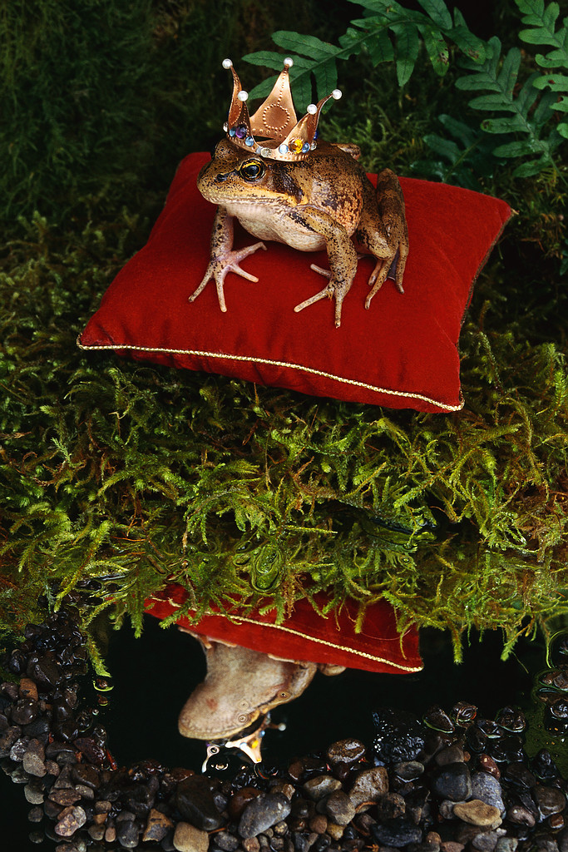
Thank you!
This study was funded by a grant from the University of Michigan Center for Health Communications Research with funding from the National Cancer Institute

