Slide 1
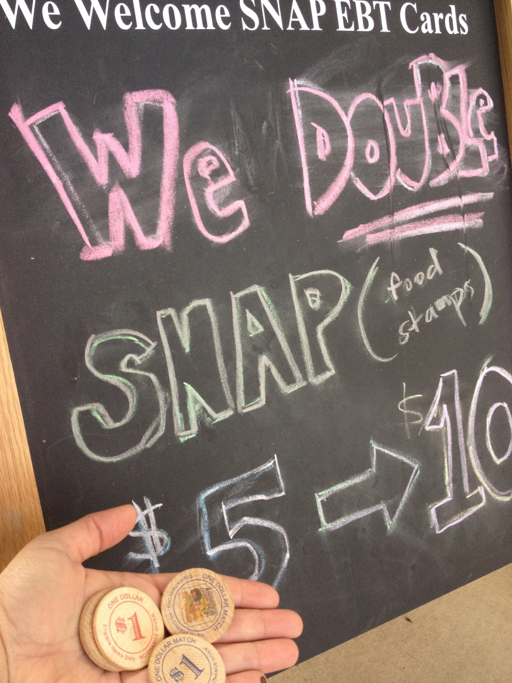
Community Organizing for
Implementing Healthy Food Incentives

Slide 2
Healthy Food Incentive
Overview
Benefits
-Increased consumption, access, and affordability of fruits and vegetables among underserved customers.
- Improved the local economy and increase sells for local farmers.
Notes:
Incentive program which provides bonus or matching funds for SNAP usage at markets can be a great way to entice new customers to markets and increase the sales for farmers. These programs demonstrated results of: increased consumption of F&V, increased sells for farmers, farmer expanding, and increased redemption of SNAP at Farmer’s Markets.

Slide 3
Incentive Success in SC
Right Choice, Fresh Start Orangeburg
Hub City Farmer’s Market, Spartanburg
Colleton County Farmer’s Market, Walterboro
Notes:
Orangeburg was the inspiration for the state-wide program which matched a $5 match for the first $5 spent in food assistance dollars. Four times more SNAP dollars came to the farmers market.

Slide 4
Proviso
38.26. (DSS: SNAP Coupons) The Department of Social Services shall establish a program to provide coupons that will allow Supplemental Nutrition Assistance Program (SNAP) recipients to obtain additional fresh fruits and vegetables when purchasing fresh produce at grocery stores or farmers markets with SNAP benefits through their EBT cards. Each coupon shall allow the beneficiary to double the amount of produce purchased, up to five dollars. The agency shall utilize all funds received in the prior and current fiscal years from the U.S. Department of Agriculture as a bonus for reducing the error rate in processing SNAP applications to fund the program.
Notes:
$1.892 million bonus money SC DSS received for managing the SNAP program effectively and efficently.

Slide 5
Recommendations
Implement at farmers’ markets, mobile markets, and farm/farm stands.
Have the incentive coupons at the participating farmers’ markets.
Use a system similar to the Senior Farmers’ Market Vouchers.
Allow roll over of unused funds to continue and expand the program.
Identify farmers’ market to participate.
Provide outreach to farmers and farmer’s markets on accepting SNAP and to SNAP recipients on participating markets.

Slide 6
Soliciting Input
Met with DSS
Developed Recommendations
Stakeholders signed on in support
Stakeholder meeting
Next Steps

