Slide 1
Climate Change Impacts on Agriculture
Healthy Eating in Context:
Communicating for Change
& Sustainability
3/21/14
Gwendelyn Geidel, PhD, JD

Slide 2
Crop Susceptibility to Climate Change
Abiotic effects
- Crop development and yield impacted by (exp): temperature changes
precipitation changes
Biotic effects
- impact agricultural productivity (exp) :
pest pressures
availability of pollination services

Slide 3
Climate Change effects on Production
Aggregate Effects transcend individual agro-ecosystems:
Agriculture is complex system linked to climate by temp., precip., solar radiation, and atmospheric gas composition.
Soil and water resources are impacted by same issues and represent key components of the system.

Slide 4
Climate Change effects on Soil Resources
Soils provide ecosystem services:
Nutrient cycling & delivery of nutrients for food and fiber production;
Flood mitigation thru filtration and water reservoir
Structure to support plants – multi element
CO₂ sequestration & uptake of GHG in surface and organic layers

Slide 5
Soil erosion effected by CC
Studies of field edge effects indicate major factors are:
Rainfall:
a) intensity – Hi I, short D > Low I, long D
b) increase CO₂ may lead to plant growth and ground cover – lower splash and higher infiltration,
But higher intensity may increases erosion overall.

Slide 6
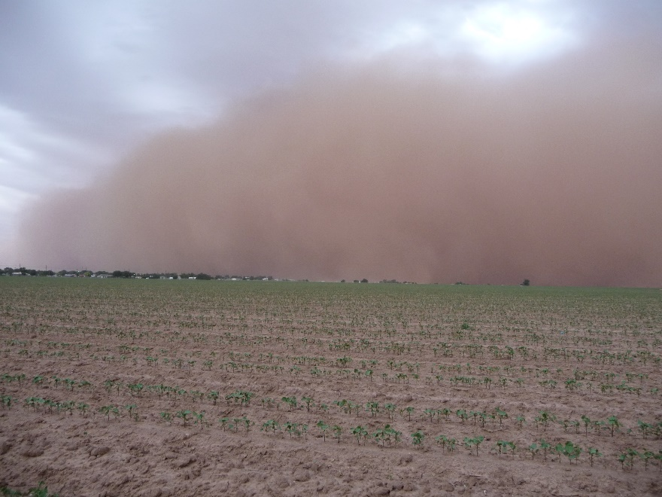
2) Snow and Winter processes- increased erosion when melt water flows over thawed soil on top of frozen soil.
3) Wind – erosion by wind impacted by velocity, soil moisture content, surface roughness, vegetation. Primary areas: Great Plains (TX – ND)
Dust storm near Lubbock, Texas
http://www.newswise.com/images/uploads/2012/05/7/duststorm.JPG

Slide 7
Changing Production and Effects on Erosion
Changes in temperature and ppt. are changing the types of crops planted, dates of planting, harvest and tillage and crop management.
Mixed messages with regard to soil erosion – most studies show an increase in soil erosion (decreasing fertility), but the opportunities for increased management coupled with the varying temporal and spatial scales, may result in new models that will more accurately reflect shifts in ecosystem characteristics.

Slide 8
References
Walthall, C.L. et al. 2012. Climate Change and Agriculture in the United States: Effects and Adaptation. USDA Technical Bulletin 1935. Washington, DC. 186 pp.
Dominati, E., M. Patterson, A. Mackay, 2010. A framework for classifying and quantifying the natural capital and ecosystem services of soils. Ecological Economics, 69(9):1858-1868.
Pruski, F.F. and M.A. Nearing. 2002a. Runnoff and soil-loss responses to changes in precipitation: a computer simulation study. Journal of Soil and Water Conservation, 57(1):7-16.
Ravi, S., et al. 2011, Aeolian Processes and the biosphere. Rev. Geophys., 49(3):RG3001.
Gardner, T., et al. 2012. Pyrosequencing Reveals Bacteria Carried in Different Wind-Eroded Sediments. Journal of Environmental Quality. 41 (3). 744-753.

