Slide 1
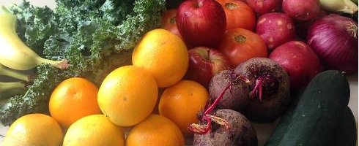
Bridging the Gap, Consumers and Producers
Marie Stallworth Director of Public Policy, Sustainable Midlands Co-Founder, Midlands Food Alliance

Slide 2
Notes:
On August 4th, 2014 a network of farm-related agencies called The Midlands Local Food Collaborative hosted The Future of Midlands Farms and Food Summit. Over 100 farmers, Ag educators, chefs, extension agents, food writers, producers, and eaters gathered to discuss the most pressing issues involving farming and eating in the 50 mile radius surrounding Columbia, South Carolina referred to as “The Midlands”. After the summit, community members had selected four areas of focus for Midlands food systems work (Farm to School/Farm to Institution, Land Access, Agriculture Education, and Farm Labor) yet no local-food-focused, grassroots entity existed to work on these issues. The Midlands Food Alliance was formed the last week of September 2014 as a grassroots group under the nonprofit Sustainable Midlands umbrella to advocate and educate for a sustainable and equitable, localized food system in the Midlands of South Carolina.

Slide 3
Geographical Focus

Slide 4
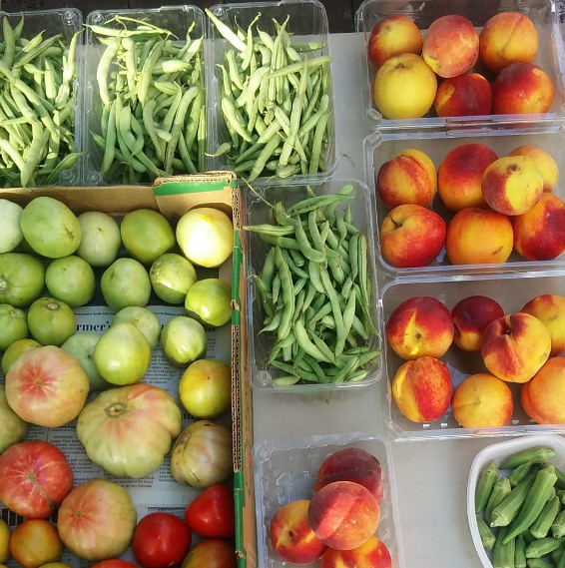
Core Values
Fairness
Security
Health
Sustainability
Equitability
Dependable
Competence
Notes:
Established Core Values---what we’ve found looking at other strong, local food systems and addressing the issues in our communities here

Slide 5
Vision for the Midlands Food System
Consuming Seasonal/Regional/Local Food
Less Fast Food
More Time Spent in the Kitchen
Food Self Sufficiency
Honest & Transparent Food Production & Purchasing
Local Food Available in Schools
Food Literacy
Not inundated with Cheap Calories
No Children/Elderly Hungry
Notes:
Established our Vision ….The GOAL of ALL of our work is FOOD Transparency-who’s growing, what they’re growing-where are areas lacking food-where is there lack of support for local food-producing farmers

Slide 6
Notes:
Farmers were hit bad in SC by the flood….yes many farms are row-crop farms and not necessarily producing food for direct human consumption but some were!
35 of our SC Counties were claimed as Disaster Areas.
“We will talk about 2015 as one of the really, really bad years,” said Charles Davis, a Clemson University extension agent who oversees Calhoun and Richland counties. “The drought got the first half of our crop, and the flood got the second half, and that left us with basically nothing.”
Why doesn’t crop insurance help more?
The 2014 Farm Bill eliminated direct, guaranteed payments for disaster relief and forced farmers to estimate how much of their crops to insure.
“With the overhaul of the farm bill, disaster payments are a thing of the past,” said Stephanie Sox, S.C. Department of Agriculture communications director. “There’s a misconception from our state leadership because crop insurance is not designated for disasters like what we had, and even the best insurance money can buy still leaves a lot on the table that it doesn’t cover.”
Even farmers who bought proper crop insurance and filed their claims meticulously couldn’t have been prepared for the double calamity of the drought and the flood.
Most farmers can afford policies that cover only 65 to 75 percent of their crops, according to Clemson agricultural economist Nathan Smith.
Plunging cotton and peanut prices further complicate things for farmers trying to dig themselves out of debt.
“There is great concern in the agricultural community that at the end of 2016 it could be much worse than at the end of 2015,” Ott said.
This especially will affect smaller and family farms, extension agents say, and may discourage younger S.C. farmers who are just starting out.
“It’s years like this that make it extremely difficult, especially for the younger guys trying to take over a part of their dad’s farm, to get established, so when he retires it will stay in the family,” Davis said.
Many may be one storm away from abandoning farming altogether.
For now, they are hoping the money in the House’s proposed state budget bill comes through and are asking Haley to give them a small part of the federal money. Although it would make only a dent in the losses, the extra $17 million the state received in addition to Haley’s $140 million request would help, Ott said.
“If we don’t plant another crop in April or May, it’s over.” he said. “It’s the only hope a farmer has now.”
Read more here: http://www.thestate.com/news/politics-government/politics-columns-blogs/the-buzz/article64621712.html#storylink=cpy
So important right now to connect consumers with opportunities to support farmers locally.

Slide 7
Notes:
Awarded a USDA Farmers Market Promotion Program Grant to Connect Consumers and Producers that includes a Farm Tour as well as mapping the Midlands Food System and develop a Food Guide and engage Midlands residents in a Local Food Pledge.

Slide 8
Farm Tour Objectives:
Educate the Public about the Current Midlands Local Food System
Increase the Customer Base of Midlands Food-Producing Farmers
Increase the Amount of Money Consumers Spend on Direct Farm Purchases
Make Farm Tour Participation Accessible to All
Connect Farmers with Training for Continued Agritourism
Build a Network of Food Producing Farmers and Supporters in the SC Midlands
Notes:
Farm Tour Objectives:
Educate the Public about the Current Midlands Local Food System
The Midlands Farm Tour will educate participants about the value, importance, and diversity of agriculture in our region through learning about production practices, barriers to market, how food is processed and distributed, and the individual farmers’ stories. Host farms will undergo training one month before the tour to learn how to best communicate what’s farmed in the Midlands region and what’s not, farming practices, and the importance of supporting local farms.
Increase the Customer Base of Midlands Food-Producing Farmers
By six months after the Midlands Farm Tour, the farms participating in the Midlands Farm Tour will have increased their customer base by as measured by the pre and post survey of producers.
Increase the Amount of Money Consumers Spend on Direct Farm Purchases
Beginning the week after the farm tour, consumers who signed the pledge will begin spending at least $10.00 weekly on direct farm purchases as measured by the number of commitments made on the farm tour and a post survey conducted three months after the farm tour of those who committed. The survey will also measure why those who committed kept or did not keep their commitment.
Make Farm Tour Participation Accessible to All
The Midlands Farm Tour will be free to participants with WIC Vouchers and SNAP EBT cards. The tour will cost $10 per person or $25 per car if participants are able to pay. The Midlands Food Alliance will work to partner with local churches and organizations who have gardening projects to provide transportation for those unable to drive themselves.
Connect Farmers with Training for Continued Agritourism
Farms that are interested in becoming agritourism enterprises seasonally or year round will be connected with the South Carolina Department of Agriculture for further training and marketing assistance.
Build a Network of Food Producing Farmers and Supporters in the SC Midlands
This base of local food supporters can be used to support food producing farmers in their efforts and hurdles they face in expanding to new markets, producing new product, and teaching others how to do the same. The Midlands Food Alliance meets monthly, has launched a monthly newsletter, organized a Midlands Local Food Guide and is hosting county potlucks for farmers and eaters who care, and is the first organization to build a network of farmers producing food and those who support them in the SC Midlands.

Slide 9
Notes:
Developed a Printed and Digital Midlands Local Food Guide in 2015 and the USDA grant is allowing us to map the Midlands food system online to then use that data to generate a local food guide and also share it with agencies like the SC Dept of Ag who are wanting to update their Certified SC Grown database.
The Midlands Farmer Survey was conducted from fall 2013 through summer 2014. The lack of comprehensive farm lists in the region was a hurdle to gathering data and communicating with farmers. The initial survey of local, food-producing farmers indicated that many farmers are not regularly communicating with each other, potential customers, or agricultural organizations. 77% of Midlands food-producing farmers were interested in connecting with more customers and selling through outlets they do not currently use. Food literacy is a hurdle for these farmers' potential customers with many eaters not knowing what a food system is or where to buy food locally.

Slide 10
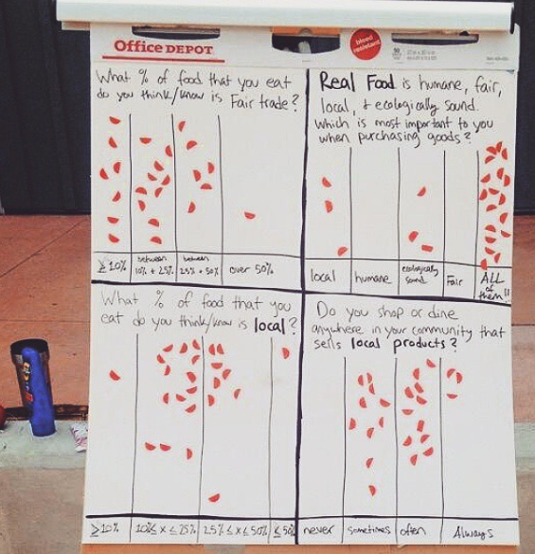
Notes:
Tabling at Farmers Markets to promote the tour and to also get folks to sign onto the Local Food Pledge. SC Dept of Ag partnering with us on the Pledge.

Slide 11
Local Food Pledge
Do you believe in supporting Midlands farmers? Do you agree we all should build a food system that provides a sustainable living for farmers and farm-workers, where all residents have access to healthy and affordable food, and our natural resources are valued?
SIGN the LOCAL FOOD PLEDGE: I pledge to spend at least $10 weekly on foods produced in South Carolina and support my county and
city leadership in prioritizing local food production.

Slide 12
Notes:
Taking Food Systems Planning into consideration with municipal and county plans is important because development is a threat to farmland.

Slide 13
Notes:
Some research has been done already by DHEC and Eat Smart Move More
To look at county plans in SC and also to offer ideal policies to be put into county plans.
The Midlands Food Alliance is building a base to support these efforts---As we all have the opportunity to usher in systemic change by supporting farmers and farmworkers in our region as well as working to value our natural resources and increase access to healthy food options. Inroads to increase market opportunities for our farmers to sell products include county plans that prioritize healthy food systems and institutional purchasing of local foods by our local schools and public agencies.

Slide 14
“Food Policy Councils foster communication and civic action at the grassroots. They’re a chance for people to shape, from the bottom up, the nature of a system that can seem distant and bewildering, even as it affects so much of their lives. Achieving food democracy and social justice is a key part of any food policy council’s mission.” - Doing Food Policy Councils Right: A Guide to Development and Action by Michael Burgan and Mark Winne

