Slide 1
University Financing and Budget Model
Faculty Budget Committee
January 26, 2024

Slide 2
External Budgeting
Notes:
******Please create a consistent look. I clicked and dragged and it’s a mess.

Slide 3
External calendar: Budget development
Process Begins for the Next Fiscal Year
Budget Request Guidelines Distributed to State Agencies
(August/September)
Budget Requests Prepared & Submitted by State Agencies
(October)
Request
Analyzed by Executive
Budget Office & Governor’s Office
(Oct/Dec)
Board of Economic Advisors Revised Estimate
(February)
Board of Economic Advisers Initial Revenue Estimate
(November)
Budget & Appropriation Bill Prepared
(January)
Governor’s Budget & Appropriation Bill Submitted to General Assembly
(January)
House Ways & Means Committee Budget Deliberations
(February)
House of Representatives Budget Deliberations
(March)
Initial Allocations to State Agencies by DOA-EBO
(August)
Governor Vetoes Line Items and/or Signs Appropriation Bill into Law
(June/January)
Conference Committee Deliberations
(May)
House gets
“Second Bite”
(May)
Senate Budget Deliberations
(April/May)
Senate Finance Committee Budget Deliberations
(April)
Comptroller General Prepares Chart of Accounts for New Fiscal Year
(June)
3

Slide 4
External Budget Calendar
Budget Development Activity (excerpt): | Month / Period
Governor: Budget requests solicited USC: Governor’s Staff / Executive Budget Office presentation USC: Governor’s Executive Budget Impact Analysis | September October January
House: USC: Ways and Means Higher Education Subcommittee presentation USC: House Budget Impact Analysis | January March
Senate: USC: Senate Finance Higher Education Subcommittee presentation USC: Senate Budget Impact Analysis | February April
Conference Committee: USC: Conference Budget Impact Analysis & merge into USC budget. | May/June
Governor’s desk/ vetoes | May/June
Board Meeting to approve USC budget | June
4

Slide 5
System State Appropriations
Includes recurring state appropriations only
5

Slide 6
in-state undergraduate tuition & required fees
6

Slide 7
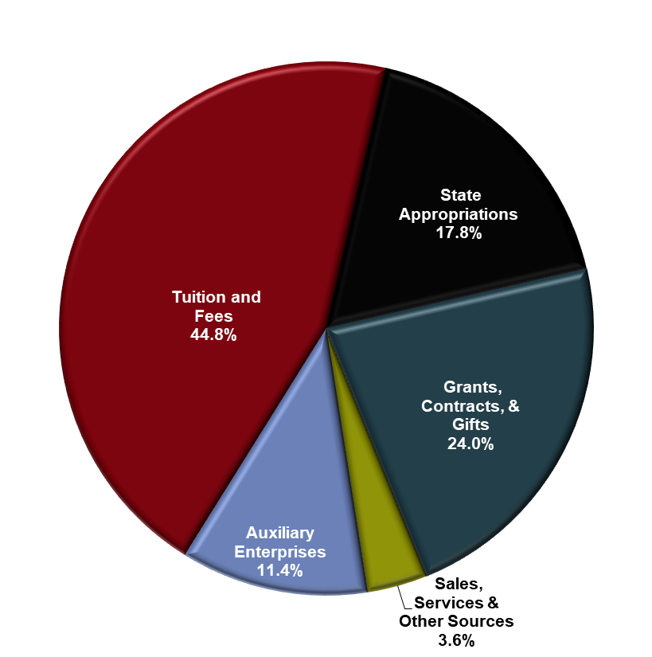
System Total Current Funds revenues
7

Slide 8
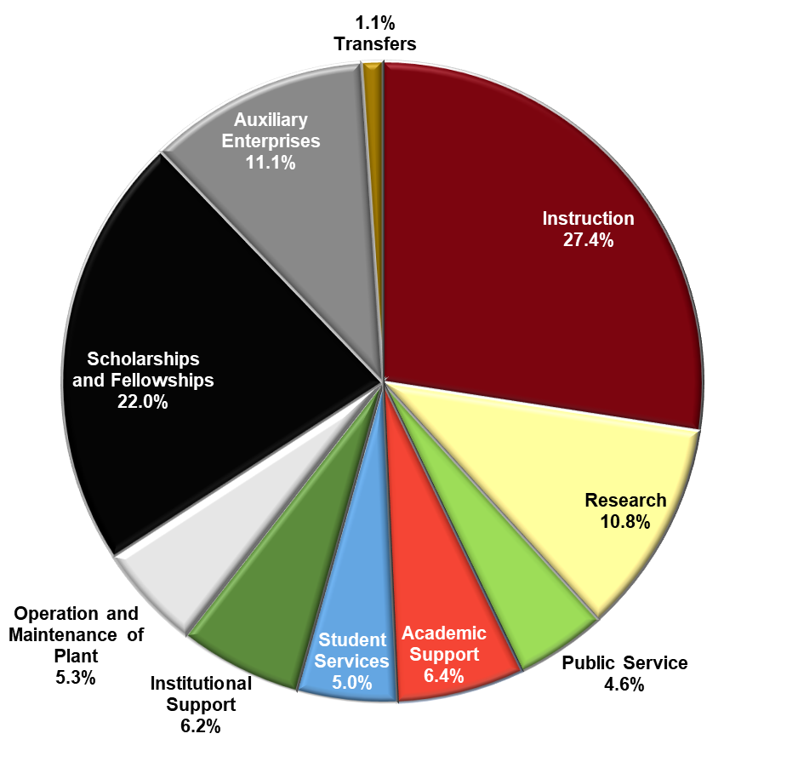
System Total Current Funds Expenditures
8

Slide 9
Internal Budgeting Budget Model
Notes:
******Please create a consistent look. I clicked and dragged and it’s a mess.

Slide 10
Internal calendar: Budget Model
Budget Development Activity: | Month / Period
Support Unit Allocation Committee (SUAC) reviews initiative requests from support units; SUAC submits recommendations to Budget Update Group (BUG); President reviews initiative requests from Support units. | October - November
Budget Update Group (BUG) reviews support unit budget requests | December
Budget Office forecasts general revenues (e.g., tuition, appropriations) and expenses (e.g., benefits) for budget development guidelines | January
Columbia Academic and Support units develop budgets based on latest analysis and central guidance | January
Conduct Academic budget hearings (i.e., blueprint meetings) | March
Campuses develop budgets based on latest analysis and central guidance | March
Academic Subvention and strategic initiative funding recommendations made and communicated | April - May
University budget updated and preliminary drafted based on current tuition/appropriation projections and trends | April – May
Budget reviewed/adopted by Board of Trustees | May – June
10

Slide 11
RCM: Budget Model Governance
Operational Support Teams
Advisory Committees
Executive Groups
Groups to meet as needed, at least twice per fiscal year.
Support Unit Allocation Committee meetings planned to begin in October and will meet as required throughout budget process. Other committees to meet as needed.
BUG meets monthly. President and Board Briefings take place regularly throughout the year.
Model Development Team
Develop budget calendar and guidelines.
Budget Model Governance Advisory Committee
Charged with advising decision makers on policy/practice matters related to format, construction and general philosophy of the budget model.
Budget Update Group (BUG)
Group responsible for financial oversight and coordination and for deploying the strategic plan on behalf of the President and Board of Trustees.
Model Analysis/ Reporting Team
Develop model reports for users at various levels and analyze mode results.
Support Unit Allocation Committee
Group charged with gathering information to provide recommendation to decision makers regarding support unit allocations.
President
Ultimate decision maker related to institutional proposals to the Board of Trustees.
Policy Review/
Development Team
Identify policies impacted by new budget model and recommend modifications and/or development of new policies
Courses & Curricula Committee (Existing)
In addition to current roles, expands charge to consider proposals for new courses to avoid unnecessary course duplication or “gaming.”
Board of Trustees
Final decisions related to the budget.
Training Team
Respond to budget model training requests to enhance budget model understanding across various groups.
Space Needs and Planning Committee (Existing)
In addition to current roles, expands role to ensure that timely and accurate space utilization data is available for users of the budget model.
11

Slide 12
BUDGET MODEL UNIT STRUCTURE
Academic Units
Support Units
Auxiliary Units
Schools
Colleges
(excludes Medicine)
Central administration
Information technology
Research office
Provost office
Admissions
Facilities
Law enforcement & safety
SC Honors College
University Libraries
Others
Athletics
Housing
Parking services
Student health center
Auxiliary units are primarily self-supporting through ticket sales/fees. Each pay central support units for central services used.
Academic units perform teaching, research and service.
Support units assist with infrastructure.
12

Slide 13
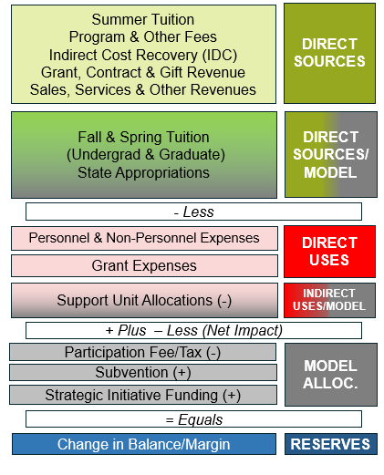
Budget model
13

Slide 14
revenues
Summer Tuition
Program & Other Fees
Indirect Cost Recovery (IDC)
Grant, Contract & Gift Revenue
Sales, Services & Other Revenues
DIRECT SOURCES
REVENUES: All academic, research, and state appropriation revenues are allocated or distributed directly to the Academic Colleges. Colleges collect tuition, state appropriations, grant, and other revenue.
Fall & Spring Tuition
(Undergrad & Graduate)
State Appropriations
DIRECT SOURCES/
MODEL
14

Slide 15
revenues
TUITION
Revenue pools – Fall and Spring tuition:
Resident 70%/30% of crhr divided by college of instruction/record.
Non-Resident 70%/30% of crhr divided by college of instruction/record.
Direct tuition – Summer and Graduate tuition:
Graduate Budget set by prior year actual and distributed by actual to college of record.
When actuals coming are more than budget, the additional tuition is distributed to Academic Units using the same % crhr hours from FY2022.
15

Slide 16
revenues
STATE APPROPRIATIONS
Resident student credit hours:
70% or $136M was distributed by proportion of Undergraduate and Graduate credit hours of resident students.
Contract and grant revenue:
30% or $58M was distributed by proportion total direct grant and contract revenue.
Portion of state appropriation is provided to research because F&A/IDC negotiated rates do not fully fund the indirect costs of research.
16

Slide 17
revenues
INDIRECT COST RECOVERY (direct)
FY2024 IDC Budget of $26M was allocated according to prior year research activity. Actual IDC receipts are distributed to the units as earned in the current year.
17

Slide 18
Direct costs/uses
DIRECT USES: Direct costs are personnel costs of the college as well as non-personnel expenditures. Sponsored award direct charges are found here.
- Essential element - Workforce planning.
- Impacted by state mandates on salary & fringe.
- Less
DIRECT USES
Personnel & Non-Personnel Expenses
Grant Expenses
18

Slide 19
Indirect costs/uses
INDIRECT USES/MODEL: The colleges fund support units (Central, President, Provost, Facilities, etc.) through indirect charges based on proportional use (concept of Cost Pools and Drivers).
INDIRECT USES/MODEL
Fixed budgets for the support units are adjusted through annual Support Unit Allocation Committee prioritizing Initiatives submitted by Support Units.
Then the President and key administrators (Provost, CFO) budget requests under advisement, along with revenue estimates to create a Budget Proposal for the Trustees.
- Less
Support Unit Allocations (-)
19

Slide 20
Support units Cost Pool Detail
Cost Pool | Support Units Included | Allocation Metric
Central Services & Administration | Admin & Finance, Business Affairs, HR, Development, Communications, etc. | Total Employee FTE
Facilities | Facility Services, Utilities, Facilities Projects | Net Assignable Square Footage
Enrollment & Scholarships | Enrollment Management and Scholarships | Undergraduate Student FTE
Information Technology | University Technology Services (DoIT), OneCarolina | Total Headcount
Libraries | University Libraries | Student FTE + Faculty FTE (less Law)
Academic Affairs | Provost, Faculty Senate, Graduate School, International Programs | Student FTE + Tenure-Track FTE
Research | Office of Research/ Research Administration | Contract & Grant Revenue
Academic Access & Degree Completion | On Your Time, Palmetto College Administration, Distributed Learning | Student FTE
Executive Affairs | Board of Trustees, President, Legal, Economic Engagement | Total Direct Expenses
Academic Support & Student Services | University 101, Residential Learning Centers, Student Affairs – Admin, Academic Support Services | UG Student FTE
Honors College | Honors College | UG Student FTE
Strategic Excellence/Efficiency | Support unit portion of excellence & efficiency initiatives | Total Direct Expenses
20

Slide 21
From Support Unit Allocation Committee to BOT – FY24
21

Slide 22
Support unit increases support mission – FY24
22

Slide 23
Model allocations
Remaining net income or loss to colleges are distributed back to colleges via Model Allocations (Participation Fee is collected and distributed as either Subvention or Strategic Initiative Funding).
+ Plus – Less (Net Impact)
MODEL ALLOC.
Participation Fee/Tax (-)
Subvention (+)
Strategic Initiative Funding (+)
RESERVES
= Equals
Change in Balance/Margin
23

Slide 24
Budget model timeline
Budget Development Activity: | Date
Budget Model is presented to Trustees as proposed by Budget Model Steering Committee. | June 2019
Incremental budgeting continues with a parallel year of Budget Model. | FY2019-20
Budget Model 1st, 2nd, 3rd years of implementation: COVID. Changes in upper administration. Strong enrollments in Undergraduate in Fall 2022. Graduate school enrollments decline with employee-market economy. | FY2020-21 FY2021-22 FY2022-23
Budget Model 4th and 5th years: growth in student body; discussions begin for Budget Model 2.0. | FY2023-24 FY2024-25
Budget Model 2.0 1st year of implementation proposed for approval by Board of Trustees. New subvention; new metrics. | June 2025 for FY2025-26
24

Slide 25
Discussion
25

